Slide 1
N=99
Rigid SAR
Soft SAR
Random assignment
Welcome and consent
Draw CAM
Adjust drawn CAM
Survey Questions
Rigid RR
Rigid RR
N=117

Slide 2
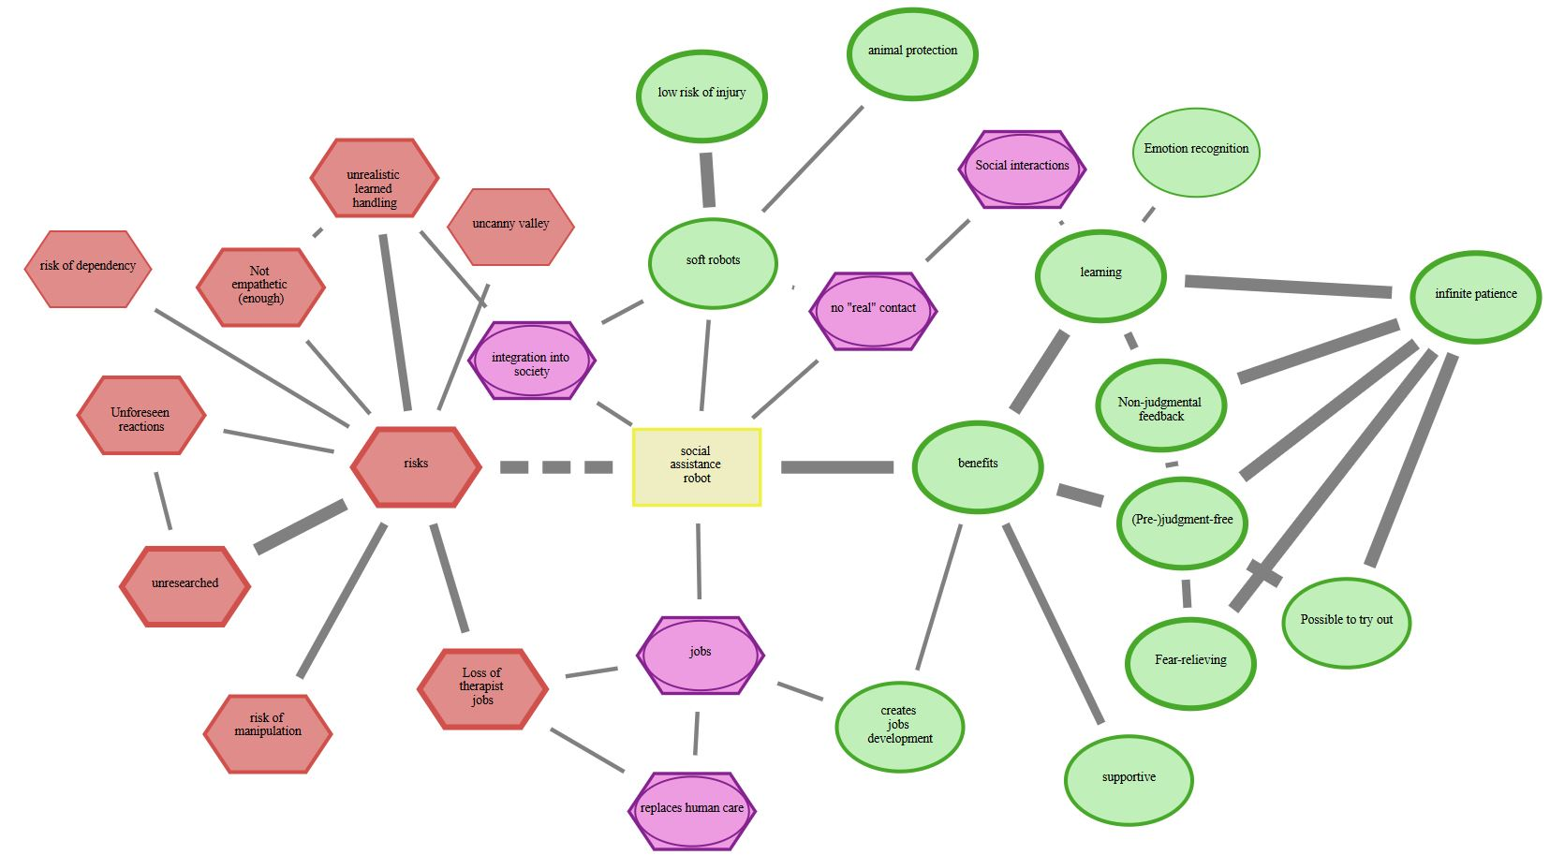
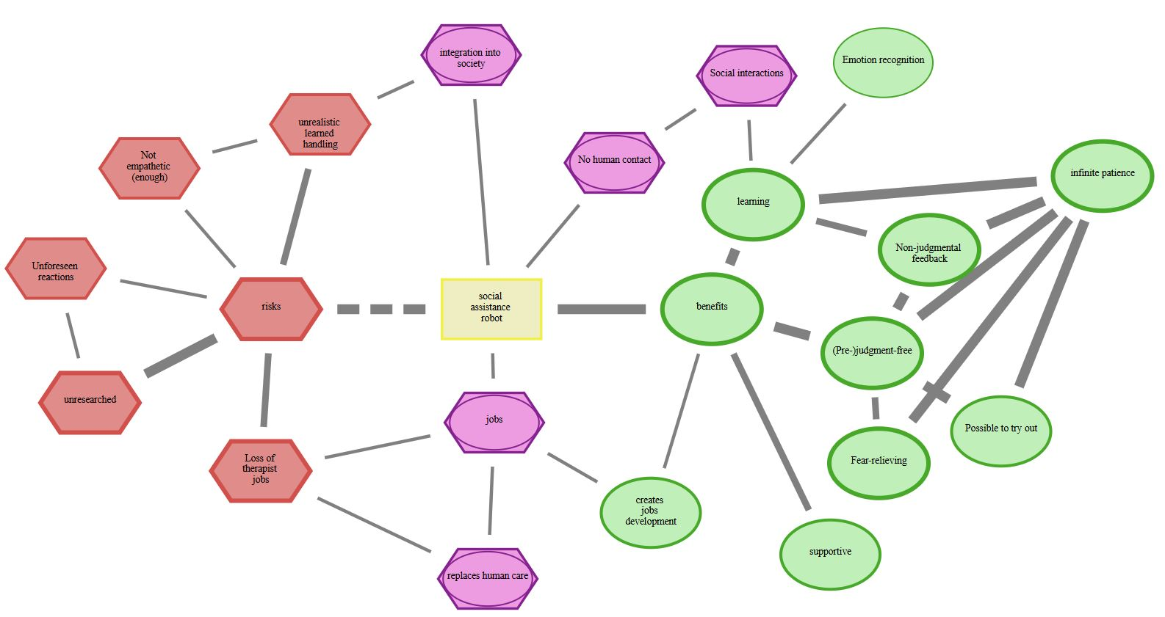


Rigid RR
Soft RR
Draw CAM
Adjust drawn CAM
Rigid SAR
Soft SAR
“deleted” (D)
“new” (N)
Added (N) and deleted (D) concepts
D
$$C_{1}$$
N
$$C_{2}$$

